Slide 1

Analysis of 2024 Election Data using Power BI
Insights into a Election Result

Slide 2

TABLE OF CONTENTS
01
02
03
INTRODUCTION
DATA STRUCTURE
DATA MERGING
04
05
06
CONTENT PLAN
BUDGET
KPI OVERVIEW
Know about Problem Statement
Know about Data Column
To Merge Data Set
04
05
06
DATA CLEANING
VISULATION
OUTCOME
Make a Structure Data Set
Dashboard
(representation of data graph)
Summary and Conclusion
Describe here the topic of the section
Describe here the topic of the section
Describe here the topic of the section

Slide 3

01
INTRODUCTION
Know about Problem Statement

Slide 4
The objective is to analyze the 2024 election data to gain insights into election results, party performance, and voter trends across constituencies. Using advanced data analysis, we aim to identify key patterns and shifts in voter behavior. Additionally, we'll create interactive visualizations and dashboards to present the findings clearly and engagingly. These tools will provide stakeholders with actionable insights, aiding informed decision-making and strategic planning for future elections.

Slide 5
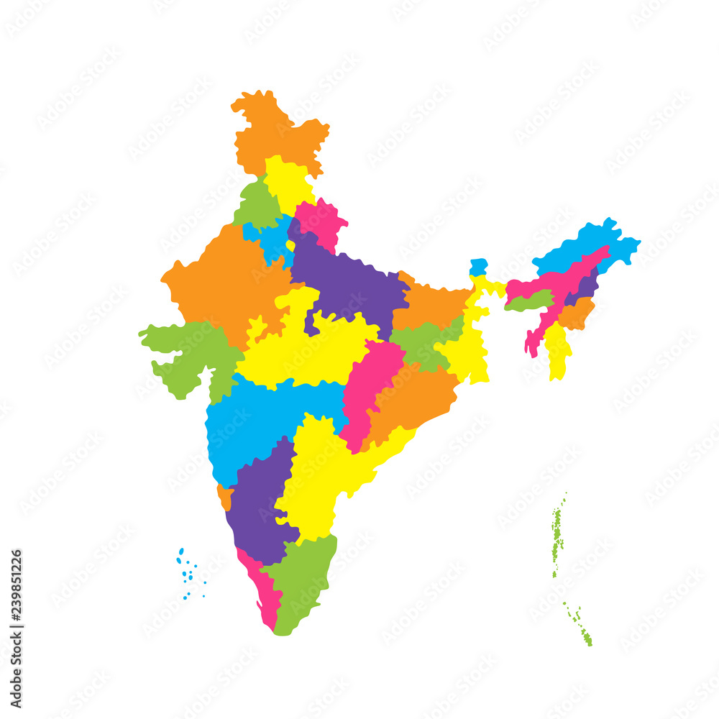
02
DATA STRUCTURE
DATA STRUCTURE

Slide 6
Party Alliance Data Column
Party Name: Name of the political party.
Alliance Name: Name of the political alliance the party belongs to.

Slide 7
Election Result Data Column
id: Unique identifier for each record.
State: Name of the state.
Const. No.: Constituency number.
Constituency: Name of the constituency.
Leading Candidate: Name of the leading candidate.
Leading Party: Name of the leading party.
Trailing Candidate: Name of the trailing candidate.
Trailing Party: Name of the trailing party.
Margin: Vote margin between the leading and trailing candidates.
Status: Status of the election result (declared or not).

Slide 8

03
DATA MERGING
To Merge Data Set

Slide 9
Merge the Data Set
We merged election results data with party alliance data to create a comprehensive dataset. This integration offers a detailed view of which alliances are leading or trailing in different constituencies, enabling an in-depth analysis of political power distribution and voter preferences. This comprehensive approach provides valuable insights into the dynamics between political alliances and their influence on election outcomes

Slide 10


04
DATA CLEANING
Make a Structure Data Set

Slide 11
Issues to Correct
Missing Values: Detect and handle missing values to avoid gaps in analysis.
Data Type Consistency: Ensure all data types are consistent and correct.
Correct Errors: Identify and fix errors to maintain dataset accuracy and reliability.
Null Values: Identify and address null values to ensure complete data.

Slide 12

05
VISULATION
Dashboard
(representation of data graph)

Slide 13
Dashboard OverView
Interactive Dashboard: Created in Power BI for analyzing 2024 election data.
Filters: Explore data by state, constituency, party, alliance, and status.
KPIs: Includes total seats won, winning margin, and constituencies won by alliances.
Visualizations: Summarizes overall results, state-wise performance, constituency analysis, party and alliance comparisons, and trends.

Slide 14
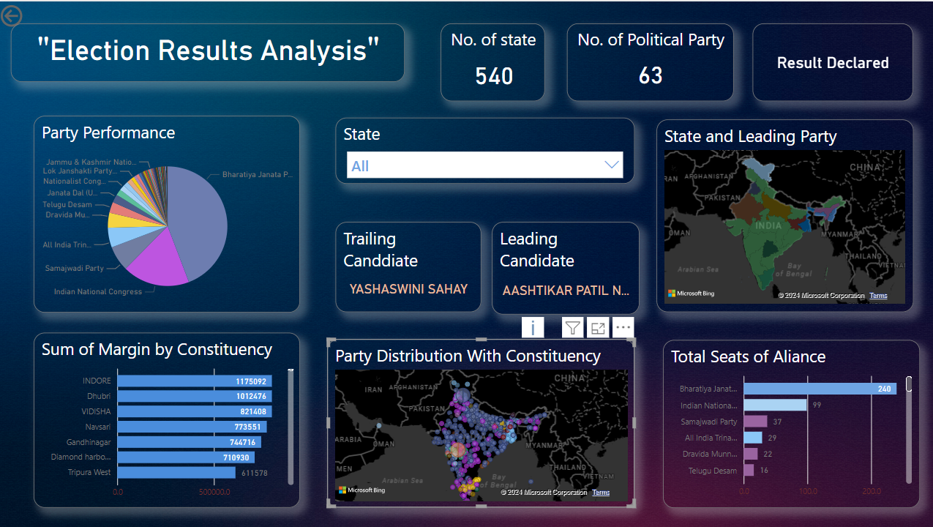
DashBoard

Slide 15
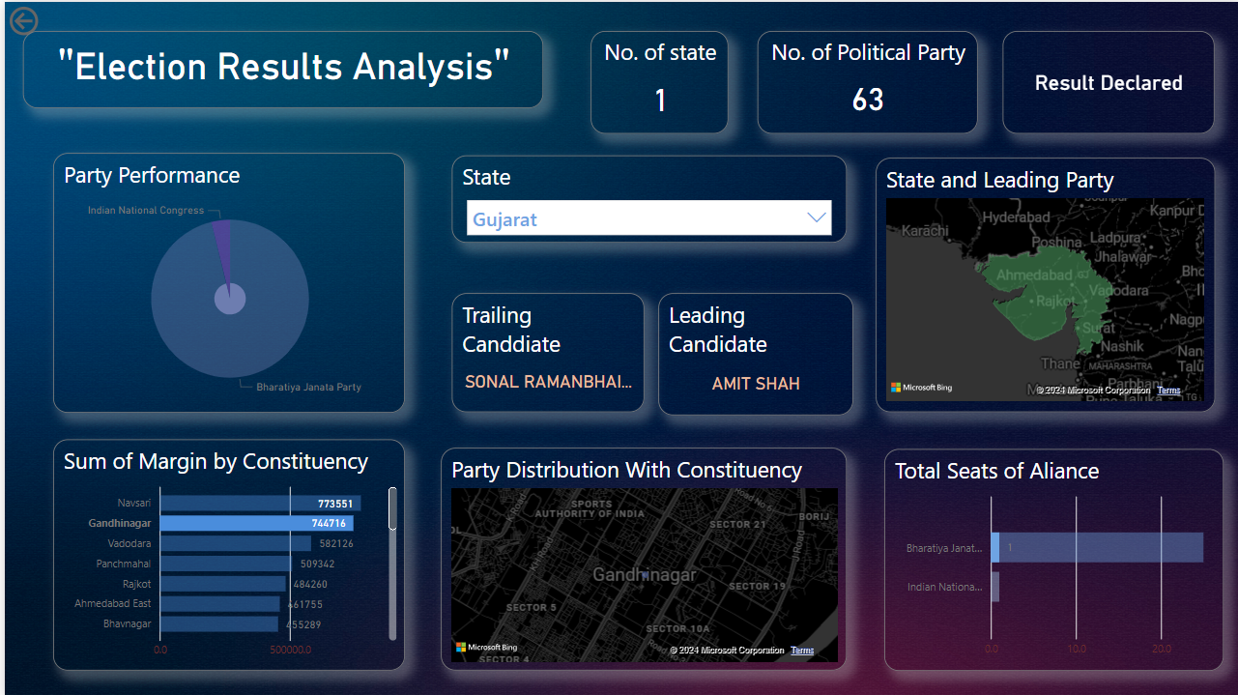
DashBoard

Slide 16

06
OUTCOME
The examination of the 2024 election data unveils crucial insights into party achievements and voter trends across various constituencies. Leveraging an interactive Power BI dashboard, stakeholders can delve into comprehensive election outcomes, including participating parties’ diversity and electoral victories. Visual aids, such as bar graphs, vividly illustrate the distribution of seats held by each party across constituencies, providing a lucid portrayal of political dynamics. This tool facilitates informed decision-making by emphasizing the influence of political alliances and enabling strategic planning for forthcoming elections

Slide 17
Thank You
Do you have any type of question regarding to Power BI or dashboard feel free to send a message on Linkdin?

